Slide 1


Introduction to Data Science And Analytics Project Group 1
Group Members
Şevvalnur Kahraman-150116822
Nurcihane Köroğlu -150115062
Emine Feyza Memiş-150114077
Gizem Aybüke Çeri-150315060
Yiğit Hallaç -150714036
Amine Boumuson-199518004

Slide 2

Sentiment Analysis

Slide 3

Data Description:
Our dataset contains labelled with positive or negative sentiments(comments), extracted from reviews of products , movies and restaurants with their format like like «sentence score»
Score is either 1 (for positive sentences) or 0 (for negative sentences) and each sentences come from three different websites/fields :
imdb(Internet Movie Database)
Amazon(American multinational technology company)
Yelp(Restaurant)

Slide 4
Finding Dataset
Prepearing Dataset
Feature Selection
Training
Testing
Process

Slide 5
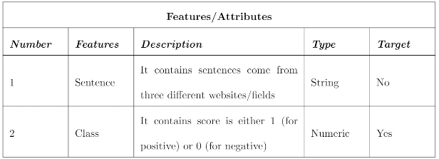
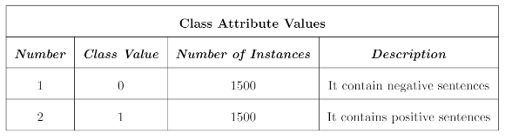
Table 1: Features/Attributes
Table 2: Class Attribute Values

Slide 6
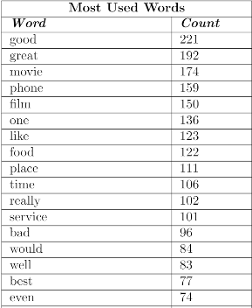
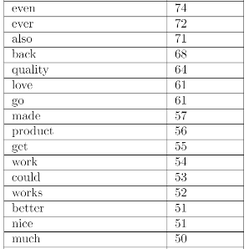
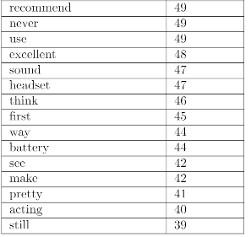
We found most used words in our dataset from all sentences
Table 3: Most Used Words

Slide 7
Some Explanations Before Finding Top Tokens:
We used python language in our Project.
We used pandas library for reading ,representing data as a data frame.
We used numpy library for array operations.
Also for drawing graphics of our final results we used matplotlib library.

Slide 8
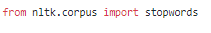
Before finding tokens in sentiments we made recovery for each sentences. For example : I ‘m to i am.
After making recovery we defined stop words in English by using nltk library and we deleted them from sentences.
We calculated term frequencies after deleting stop words from sentences.

Slide 9
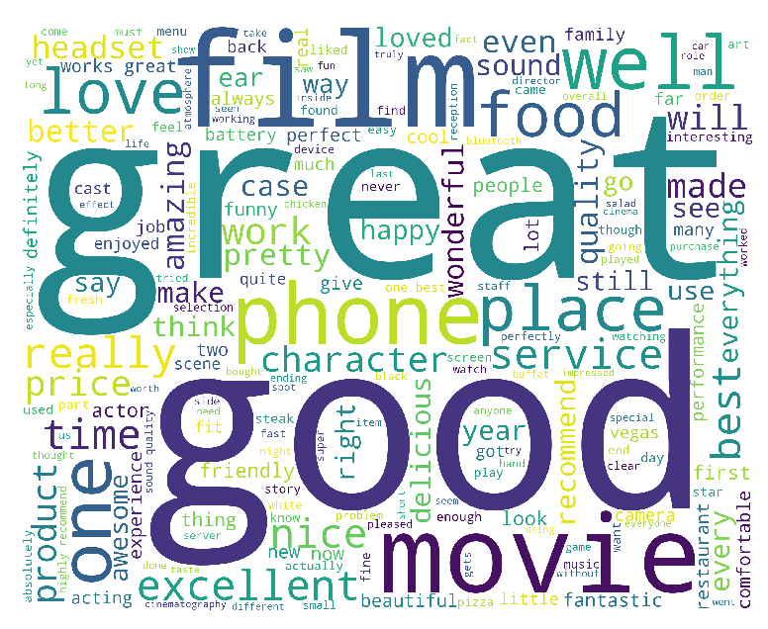
Word Cloud for good words after calculating term frequencies

Slide 10
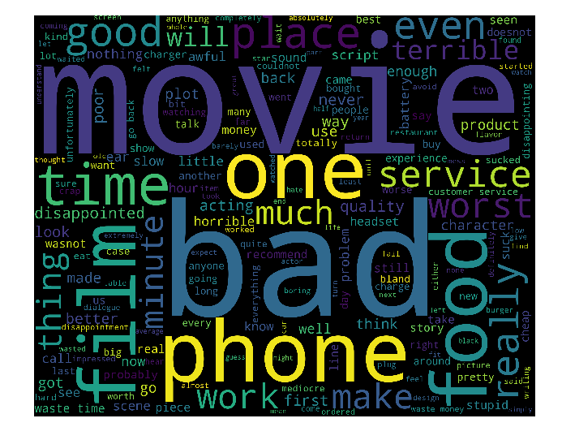
Word Cloud for bad words after calculating term frequencies

Slide 11
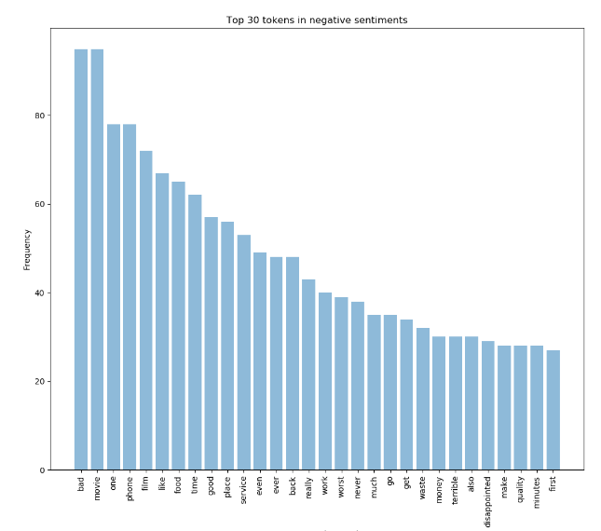
Top 30 Tokens In Negative Sentiments:
We found top 30 words in negative sentiments as frequency.
We can see from the graphic the most used word is «bad» in negative sentences

Slide 12
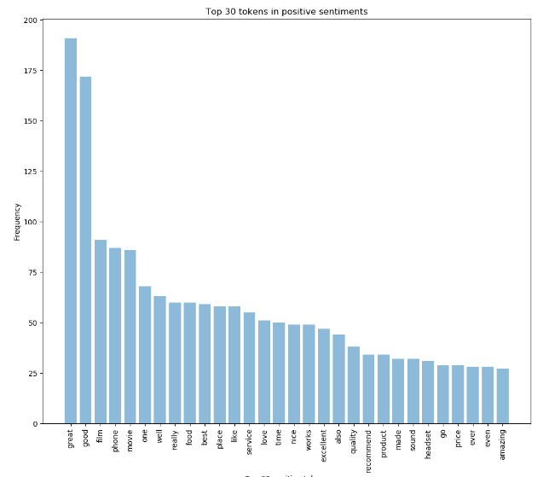
Top 30 Tokens in Positive Sentiments:
We found top 30 words in positive sentiments as frequency.
We can see from the graphic the most used word is «great» in positive sentences

Slide 13
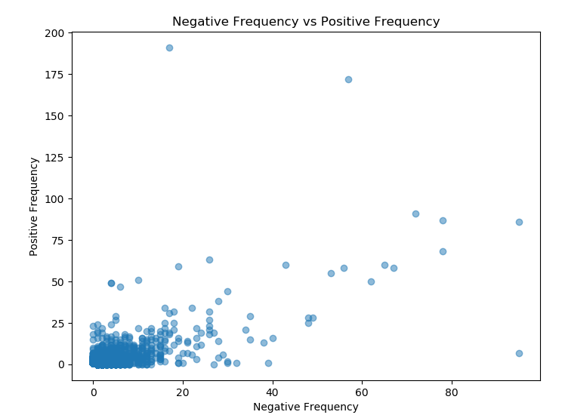
Negative Frequency vs Positive Frequency:
We made comparison negative and positive word’s term frequencies that we found before by using scatter plot.
We can see that most of the distribution is in the region near zero. The reason for this is that most words have been used for 0-20 times. Each word may not be distinctive as bad or good.

Slide 14
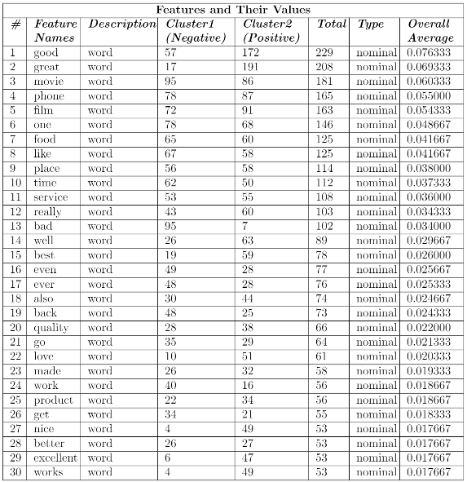
Features and Their Values of 2 Clusters With Overall Average Values

Slide 15
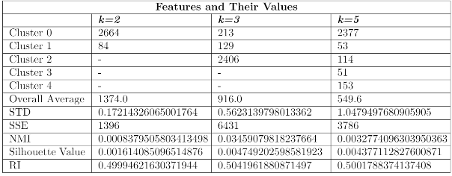
K - Means Features and Their Values For k=2 , k=3 and k=5
We calculated clusters , overall average ,STD , SSE ,NMI, Silhouette value and RI value for each k=2 , k=3 and k=5

Slide 16
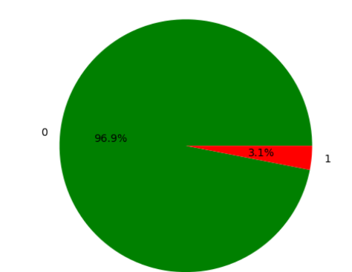
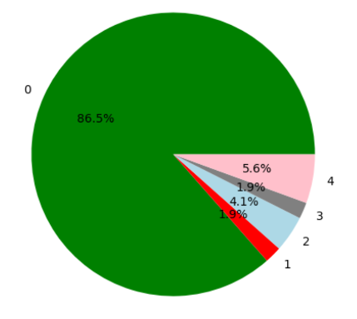
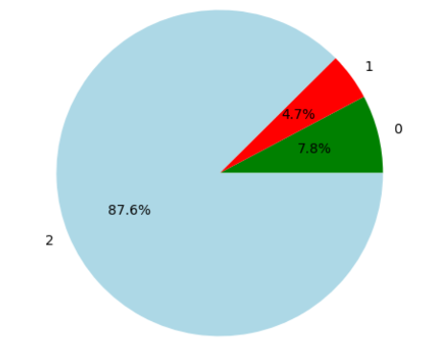
Pie chart for k=2 Pie chart for k=3 Pie chart for k=5

Slide 17
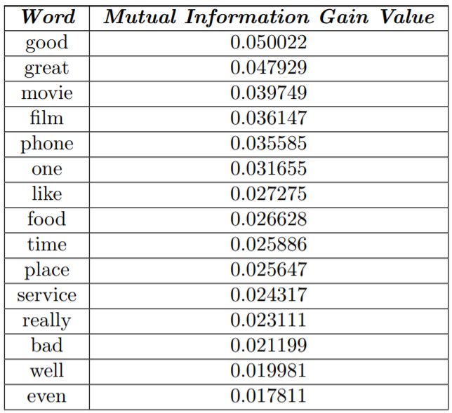
Feature Selection
Table 1: First 15 Word For Mutual Information Gain
This 15 words are the most common words in our dataset.

Slide 18
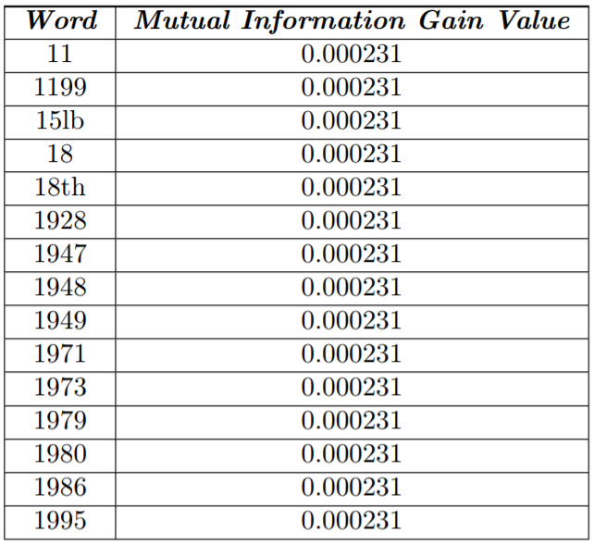
Feature Selection
Table 2: Last 15 Word For Mutual Information Gain
This 15 words are the least common words in our dataset.

Slide 19
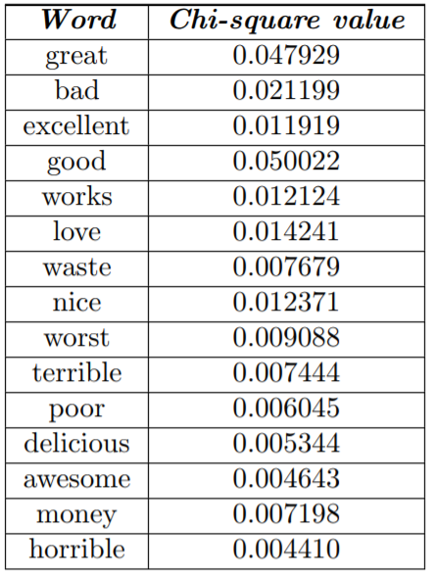
Feature Selection
Table 3: First 15 chi-square:
This 15 words are the most common words in our dataset.

Slide 20

Feature Selection
Table 3: Last 15 chi-square:
This 15 words are the least common words in our dataset.

Slide 21
Comparison of 2 Methods
Two selection method have different formulas. But they both find common words. They’re not the same words, but they’re all are the most common words in our dataset.

Slide 22
Algorithms
We did 10 tests for each algorithm. Because we wanted our results to be more reliable. We split our dataset into 10 part and we did training and testing on each of them. We did this part by using k-fold cross validation.

Slide 23
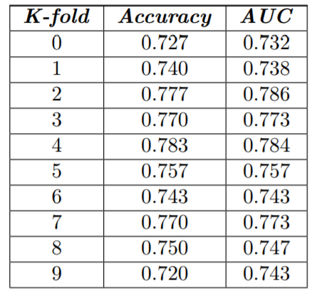
Desicion Tree
Table 5: Algorithm name: Decision Tree:

Slide 24
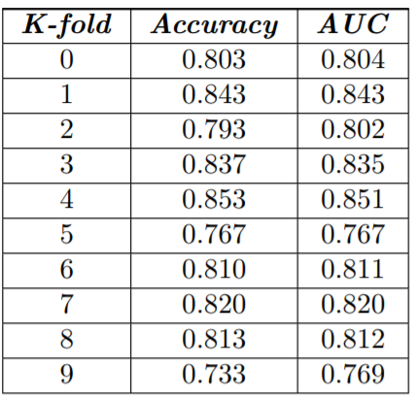
Naive Bayes
Table 5: Algorithm name: Naïve Bayes:

Slide 25
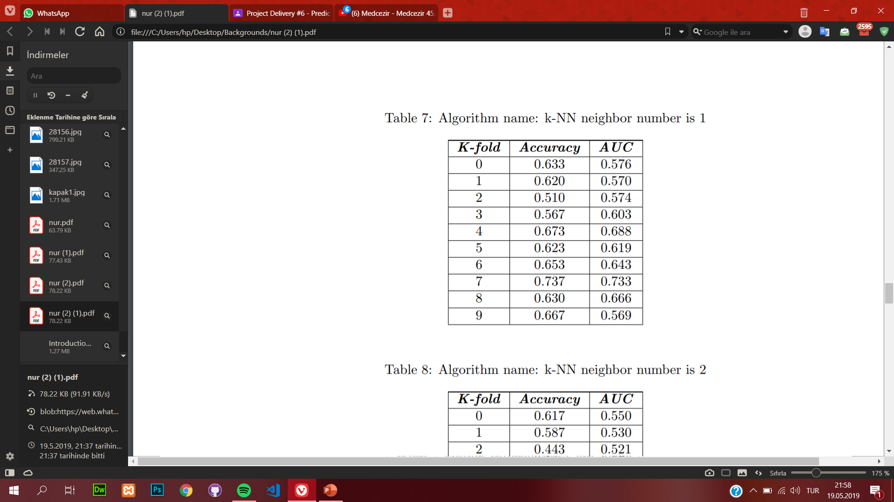
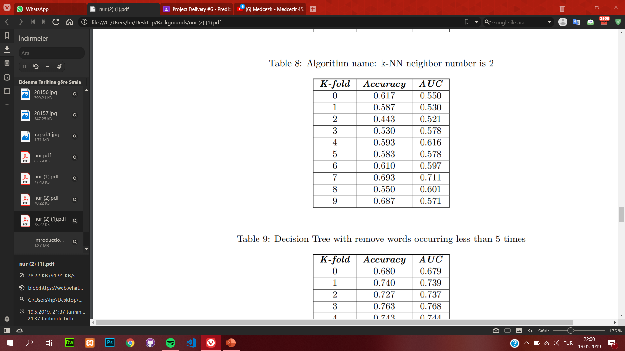
K-NN
Table 7: Algorithm name: K-NN neighbor number is 1
Table 8: Algorithm name: K-NN neighbor number is 2

Slide 26
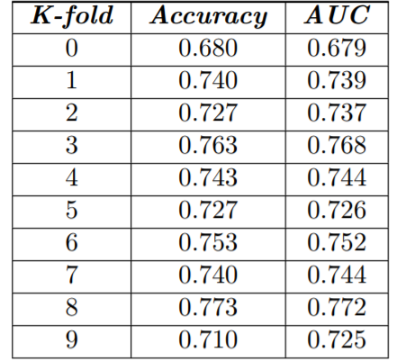
Desicion Tree
Table 9: Decision Tree with remove words occurring less than 5 times

Slide 27
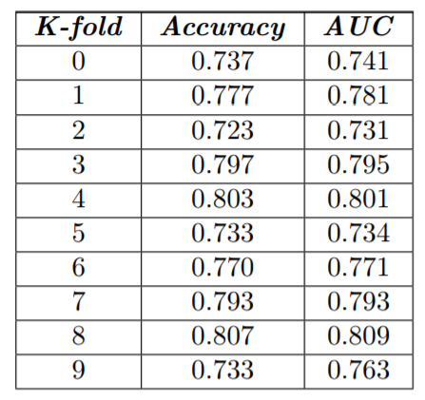
Naive Bayes
Table 10: Naive Bayes with remove words occurring less than 5 times

Slide 28

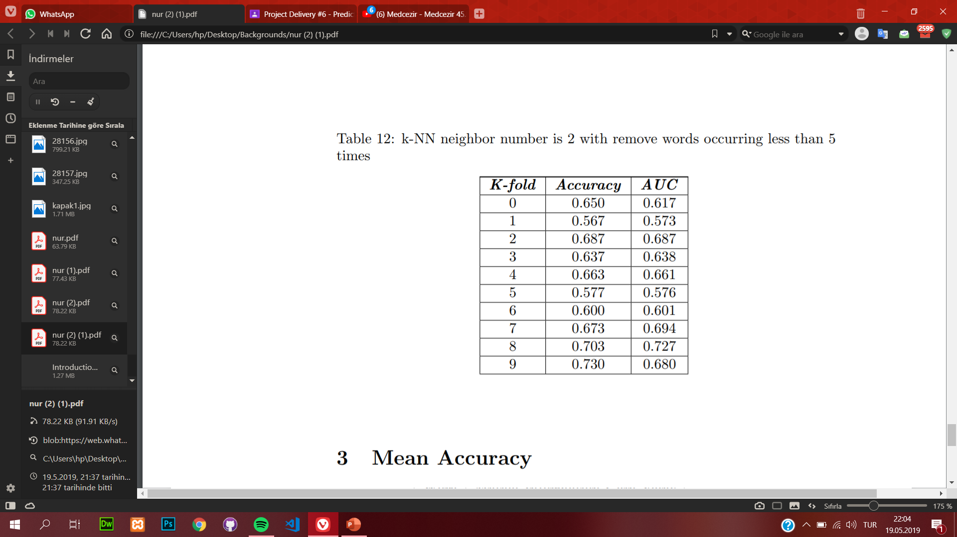
K-NN
Table 11: k-NN neighbor number is 1 with remove words occurring less than 5 times
Table 12: k-NN neighbor number is 2 with remove words occurring less than 5 times

Slide 29
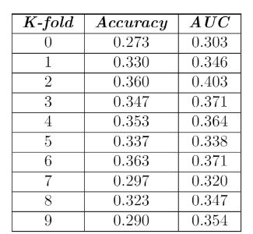
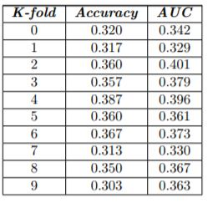
Table 13: Naive Bayes first 1000 from chi-square
Table 14: Naive Bayes first 3000
from chi-square
Naive Bayes

Slide 30
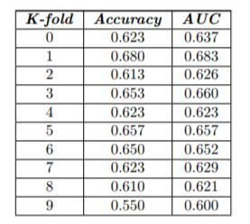
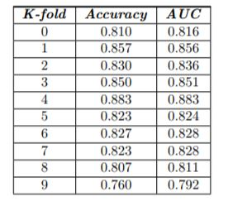
Naive Bayes
Table 15: Naive Bayes first 5000 from chi-square
Table 16: Naive Bayes with last 4000 from chi-square

Slide 31
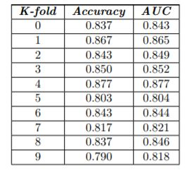
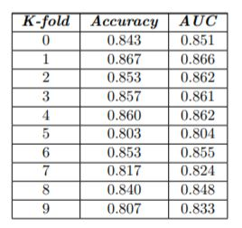
Naive Bayes
Table 17: Naive Bayes with last 2000 from chi-square
Table 18: Naive Bayes with last 1000 from chi-square

Slide 32
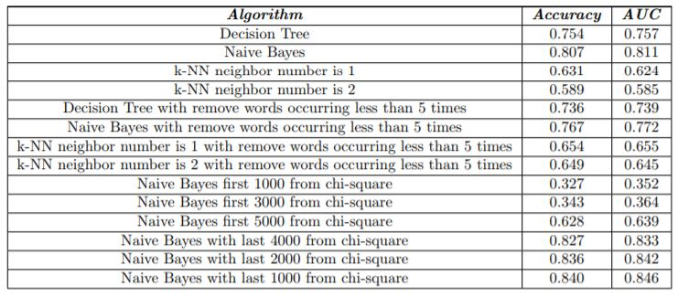
Mean Accuracy
Table 19: Mean Accuracy

Slide 33
Conclusion
We can see that k-NN algorithm with neighbor number is 2 has the lowest accuracy and AUC value. Naive Bayes algorithm has the highest accuracy and AUC value.
When k-NN algorithm neighbor number increases, accuracy and AUC value is decreases.
KNN Algorithm gives higher accuracy and AUC values when we remove the words occurring less than 5 times. But the Decision Tree and Naive Bayes gives lower accuracy and AUC values when we remove the words occurring less than 5 times.

